Slide 1


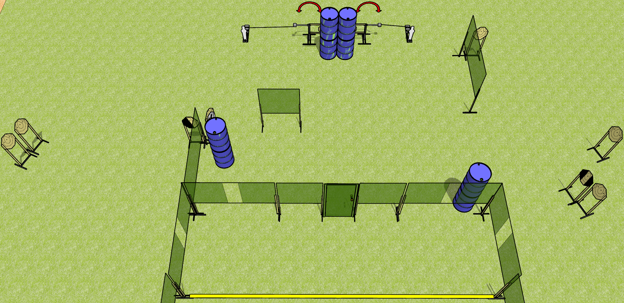
 | Dothan Gun Club – USPSA Match The 1 The Only Course Designer : Drew Coleman
Round Count 12 rounds 10 IPSC 2 mini poppers
Equipment List 2 swingers + 2 activators 6 wall feet 1 diagonal hard cover, 1 tuxedo

Slide 2
The 1 The Only
Written Stage Briefing
The 1 The Only is a 12 round, 60 point, Comstock course of fire. There are 10 IPSC targets and 2 mini poppers. The best 1 hit on paper will score, and steel must fall to score. The start signal is audible.
The left swinger is activated by the left popper, and the right swinger by the right popper. Both swingers are visible at rest. Please check the activators prior to walkthrough and set them the same way every time.
The door must be shut prior to the start signal for every shooter.
Handgun start position is heels against the rear fault line, wrists below belt. Handgun is loaded and holstered.
PCC start position is heels against the rear fault line, stock on belt. Loaded carbine is held with both hands, safety on.
On start signal, engage targets as they become available from within the shooting area.

Slide 3
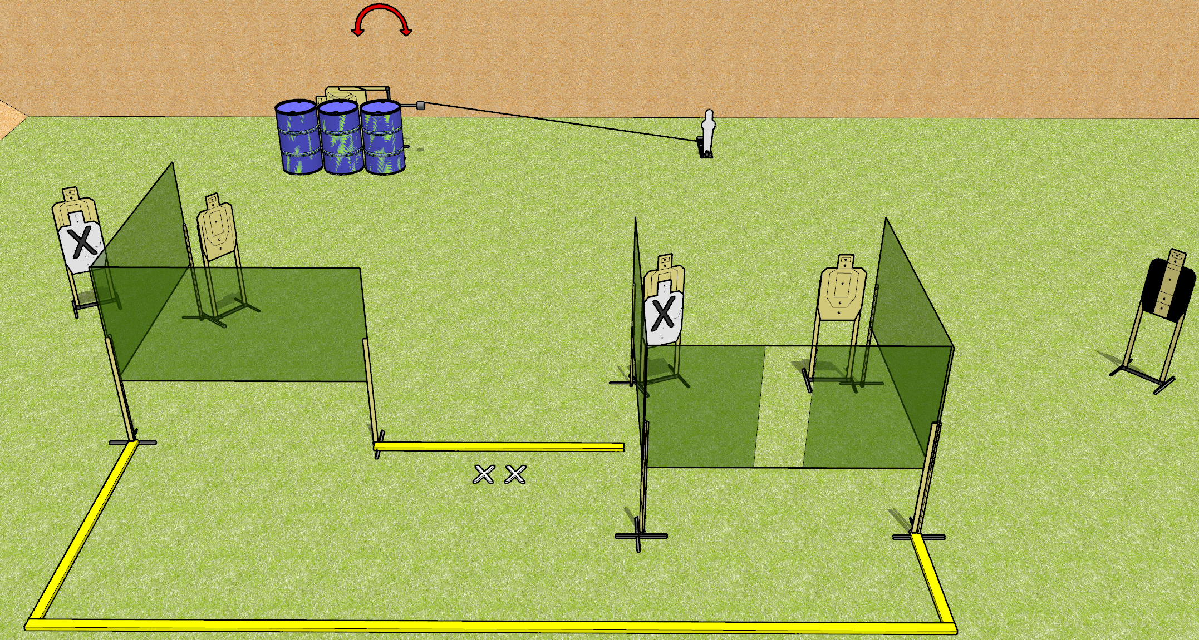
 | Dothan Gun Club – USPSA Match Almost IPSC Course Designer : Drew Coleman
Round Count 13 rounds 6 USPSA 1 mini popper
Equipment List 7 wall feet 1 medium fault line 1 swinger + activator 1 tuxedo

Slide 4
Almost IPSC
Written Stage Briefing
Almost IPSC is a 13 round, 65 point, Comstock course of fire. There are 6 USPSA targets and 1 mini popper. The best 2 hits on paper will score, and steel must fall to score. The start signal is audible.
The swinger is activated by the mini popper, and is visible at rest. Please check the activator prior to walkthrough and set it the same way every time.
Handgun start position is both feet on X’s, wrists below belt. Handgun is loaded and holstered.
PCC start position is both feet on X’s, stock on belt. Loaded carbine is held with both hands, safety on.
On start signal, engage targets as they become available from within the shooting area.

Slide 5
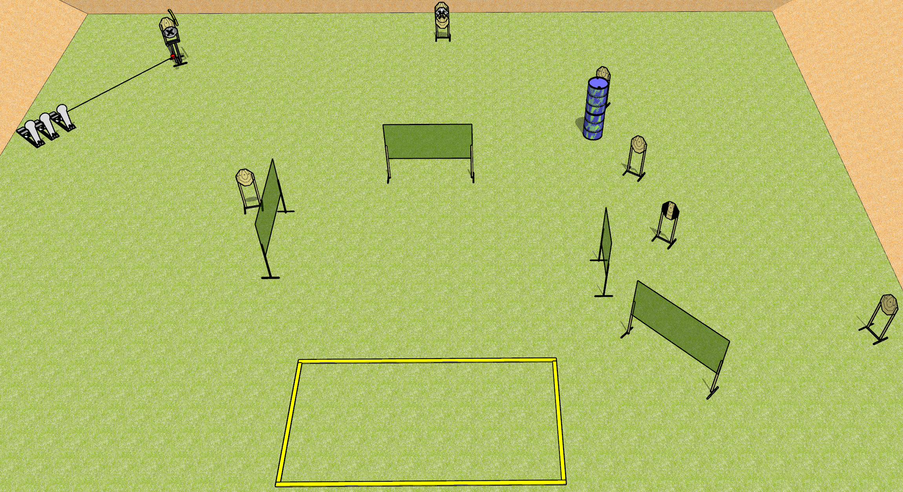
 | Dothan Gun Club – USPSA Match The Other 19 Rounds Course Designer : Drew Coleman
Round Count 19 rounds 8 IPSC 3 Colt poppers
Equipment List 8 wall feet Max trap + activator Shooting area is 20’x10’ 1 tux

Slide 6
The Other 19 Rounds
Written Stage Briefing
The Other 19 Rounds is a 19 round, 95 point, Comstock course of fire. There are 8 IPSC targets and 3 colt poppers. The best 2 hits on paper will score and steel must fall to score. The start signal is audible.
The max trap is activated by the right 2 colt poppers, and is visible at rest. It must be activated before being engaged. Please check the activator prior to walkthrough and set it the same way every time.
Handgun start position is anywhere outside the shooting area, wrists below belt. Handgun is loaded and holstered.
PCC start position is anywhere outside the shooting area, stock on belt. Loaded carbine is held with both hands, safety on.
On start signal, engage targets as they become available from within the shooting area.

Slide 7
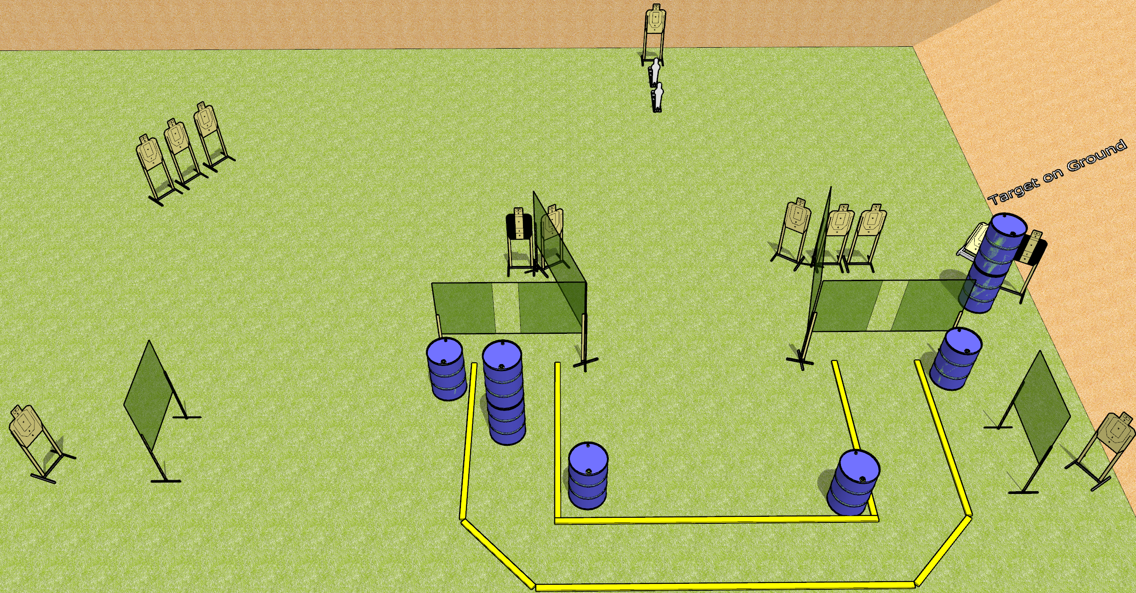
 | Dothan Gun Club – USPSA Match Droppin Mags Course Designer : Drew Coleman
Round Count 28 rounds 13 USPSA targets 2 mini poppers
Equipment List 12 wall feet 2 medium fault lines 2 tuxedos Use 10’ fault lines for the parts leading away from the ports, separate the inner 10’s by 16’ minimum

Slide 8
Droppin Mags
Written Stage Briefing
Droppin Mags is a 28 round, 140 point, Comstock course of fire. There are 13 USPSA targets and 2 mini poppers. The best 2 hits on paper will score, and steel must fall to score. The start signal is audible.
Start position is anywhere inside the shooting area, wrists below belt. Firearm is unloaded laying unpropped on any barrel. All magazines to be used on stage must start on any other barrel or barrels.
On start signal, engage targets as they become available from within the shooting area.

Slide 9
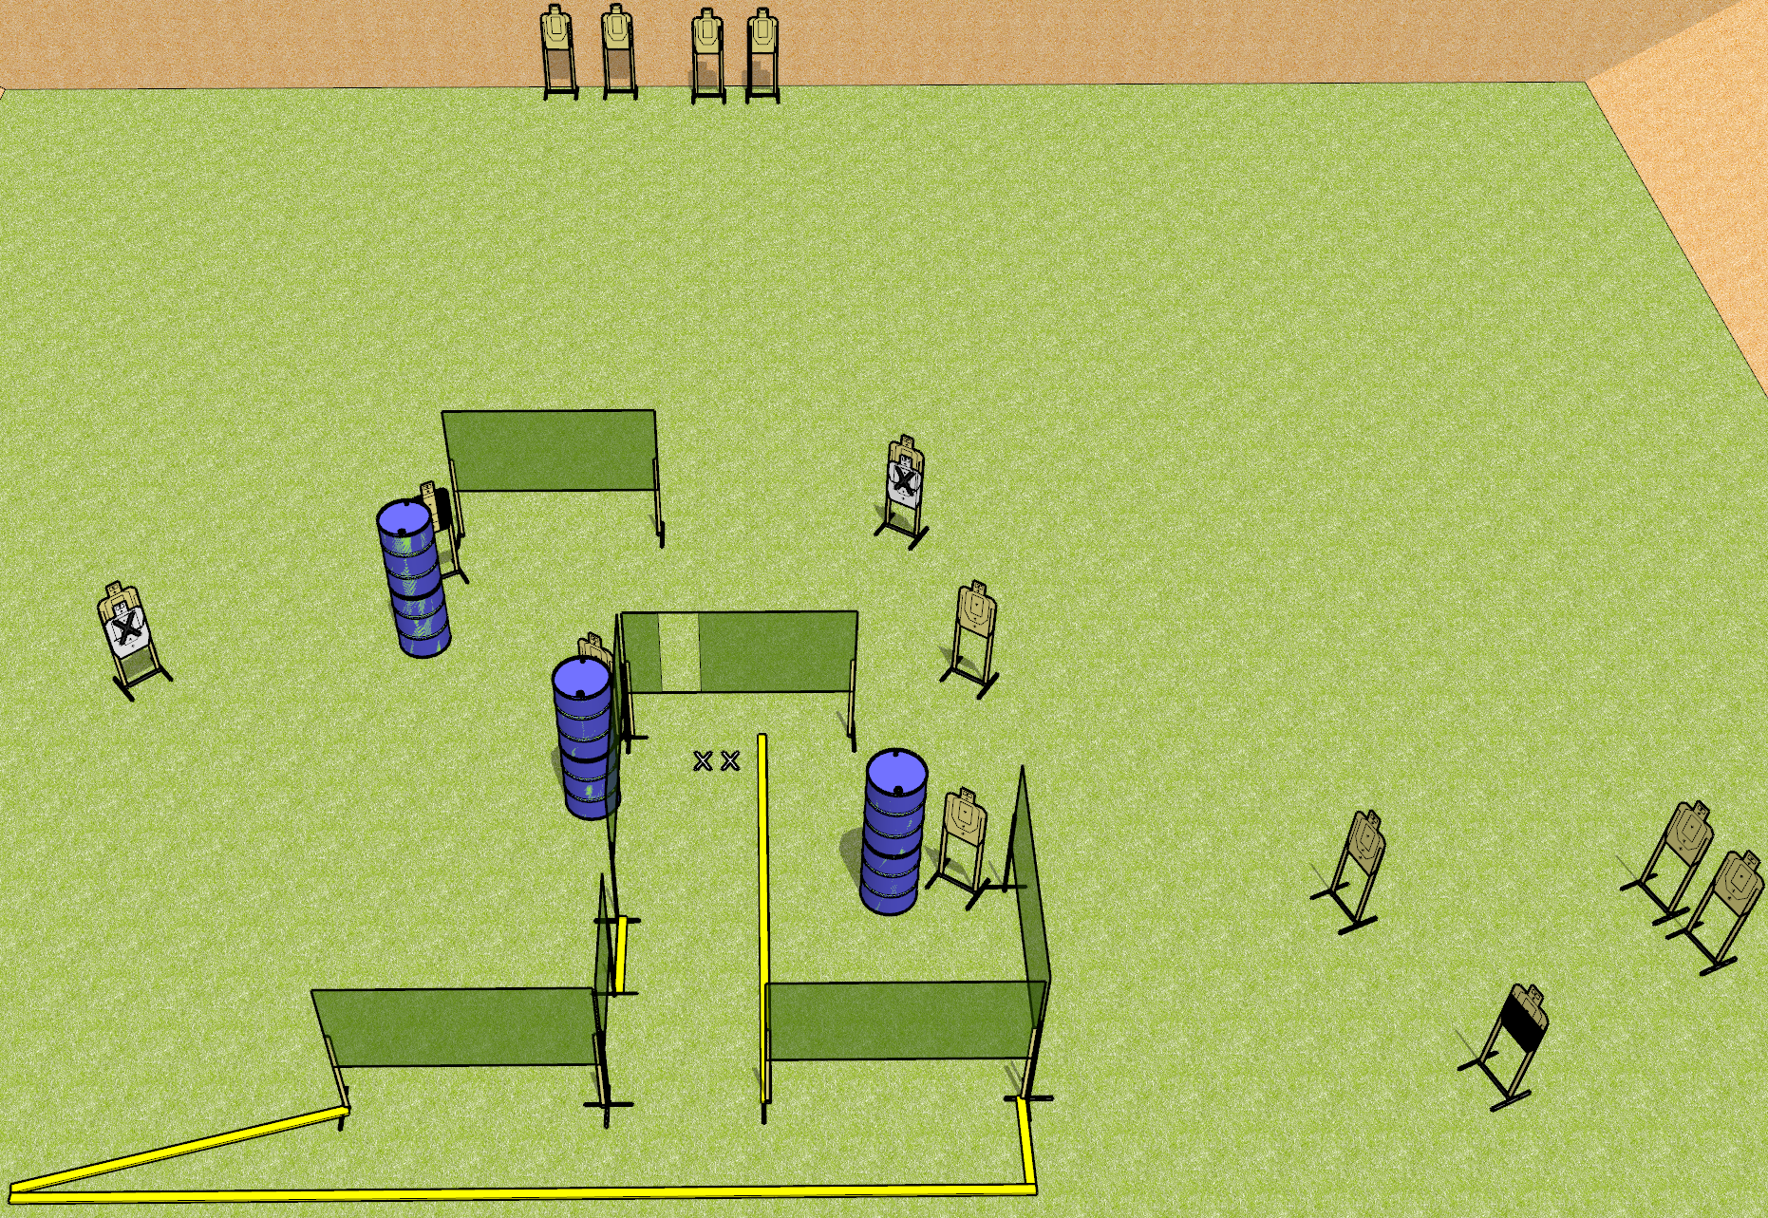
 | Dothan Gun Club – USPSA Match Use the Big Bay Course Designer : Drew Coleman
Round Count 28 rounds 14 USPSA targets
Equipment List 11 wall feet 2 3’ fault lines Use 10 foot for the far left angled part.

Slide 10
Use the Big Bay
Written Stage Briefing
Use the Big Bay is a 28 round, 140 point, Comstock course of fire. There are 14 USPSA targets. The best 2 hits on paper will score, and steel must fall to score. The start signal is audible.
Handgun start position is both feet on X’s, wrists below belt. Handgun is loaded and holstered.
PCC start position is both feet on X’s, stock on belt. Loaded carbine is held with both hands, safety on.
On start signal, engage targets as they become available from within the shooting area.

Slide 11
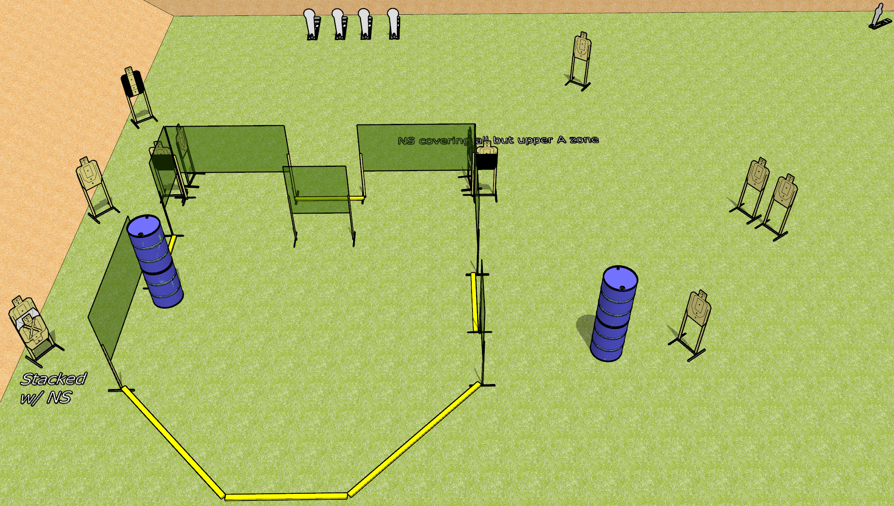
 | Dothan Gun Club – USPSA Match Lean Out Course Designer : Drew Coleman
Round Count 29 rounds 12 USPSA 4 colt poppers, 1 mini popper
Equipment List 12 wall feet 3-4 medium fault lines 1 tuxedo, 2 50%

Slide 12
Lean Out
Written Stage Briefing
Lean Out is a 29 round, 145 point, Comstock course of fire. There are 12 USPSA targets, 4 colt poppers, and 1 mini poppers. The best 2 hits on paper will score, and steel must fall to score. The start signal is audible.
Handgun start position is anywhere outside the shooting area, wrists below belt. Handgun is loaded and holstered.
PCC start position is anywhere outside the shooting area, stock on belt. Loaded carbine is held with both hands, safety on.
On start signal, engage targets as they become available from within the shooting area.

Slide 13
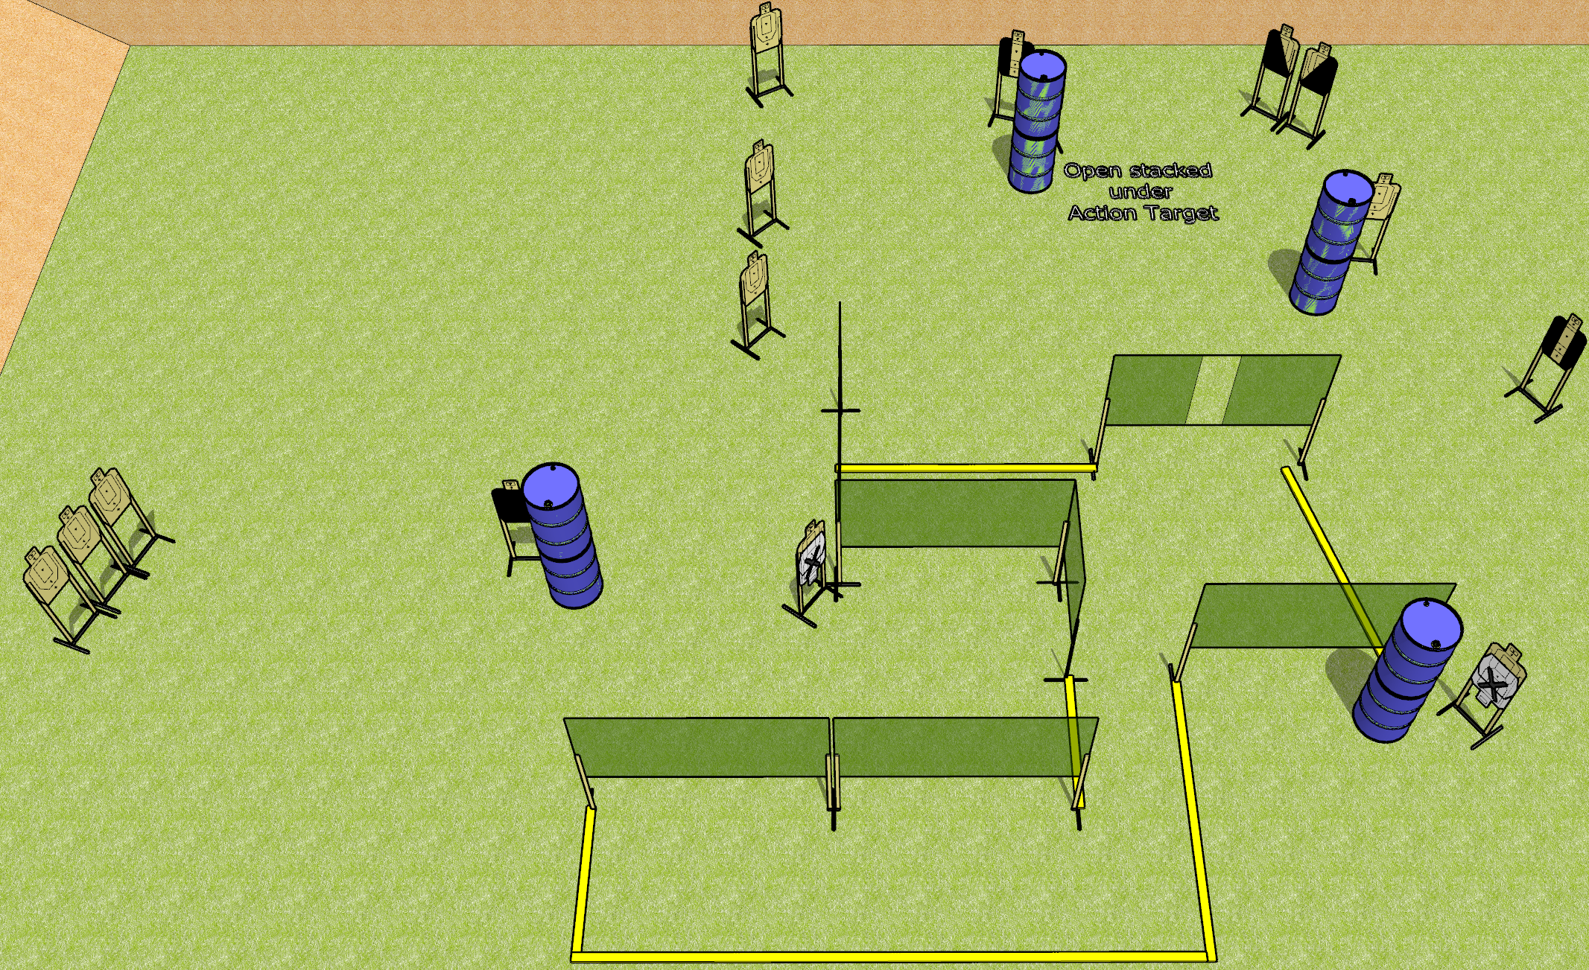
 | Dothan Gun Club – USPSA Match Break Down Course Designer : Drew Coleman
Round Count 32 rounds 16 USPSA targets
Equipment List 11 wall feet 2 medium fault lines 1 headshot, 2 tuxedos, 2 diagonal, 1 action target

Slide 14
Break Down
Written Stage Briefing
Break Down is a 32 round, 160 point, Comstock course of fire. There are 16 USPSA targets. The best 2 hits on paper will score, and steel must fall to score. The start signal is audible.
Handgun start position is anywhere outside the shooting area, wrists below belt. Handgun is loaded and holstered.
PCC start position is anywhere outside the shooting area, stock on belt. Loaded carbine is held with both hands, safety on.
On start signal, engage targets as they become available from within the shooting area.

